Slide 1
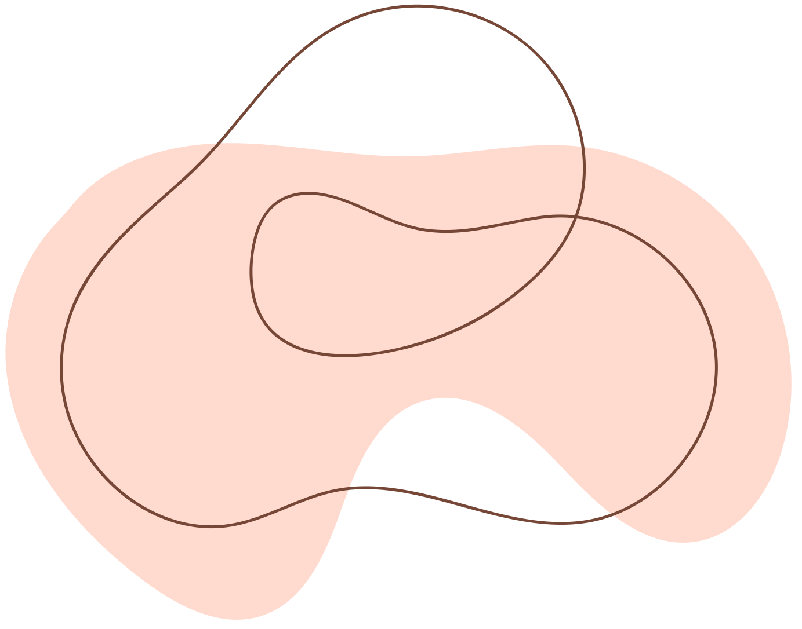
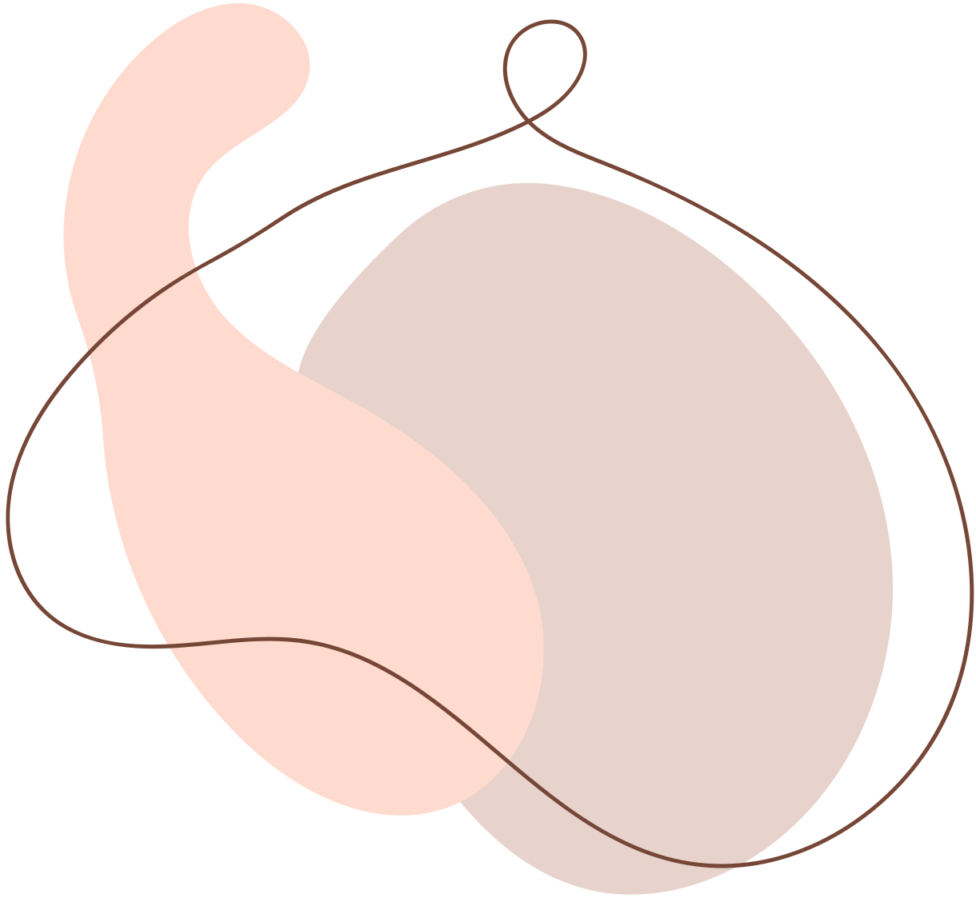
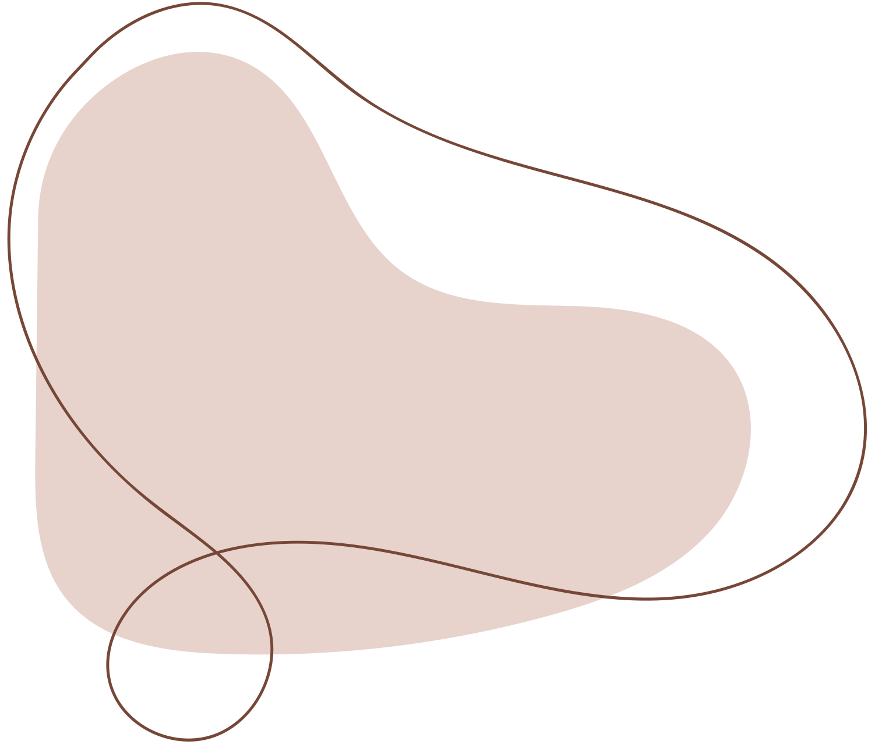

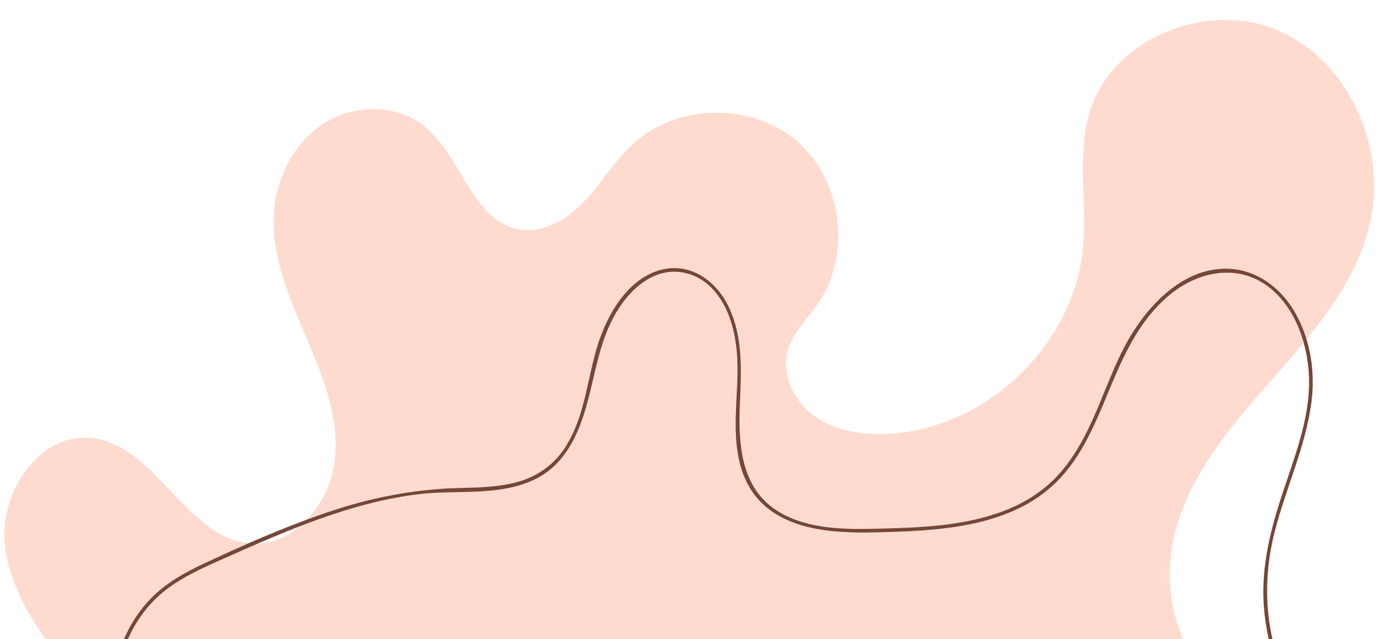
BRAIN TUMOR CLASSIFICATION & SEGMENTATION USING CNN
Presented by Adarsh P

Slide 2
INTRODUCTION
Brain tumors are serious and life-threatening conditions.
Early detection is key to improving survival and treatment outcomes.
AI enables faster and more accurate tumor detection.
CNNs analyze MRI scans to classify brain tumors effectively.
This technology enhances diagnostic precision and supports timely medical intervention.

Slide 3
GOALS
Develop a robust and accurate CNN model for brain tumor classification.
Classify different types of brain tumors from MRI scans.
Apply K-Means clustering for effective tumor segmentation.
Enhance MRI image analysis to improve diagnostic insights.
Support early detection and aid in medical diagnosis through AI.

Slide 4
DATASET
Dataset is downloaded from : https://www.kaggle.com/datasets/masoudnickparvar/brain-tumor-mri-dataset
The Brain Tumor MRI Dataset, comprises 7,023 MRI images categorized into four classes: glioma, meningioma, no tumor, and pituitary.
Need to do Augmentation , and to resize images to a single size

Slide 5
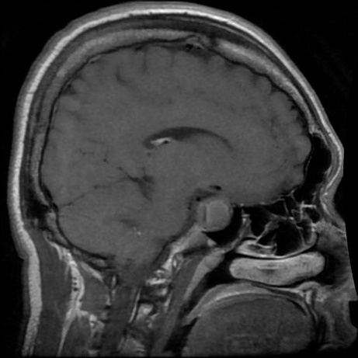
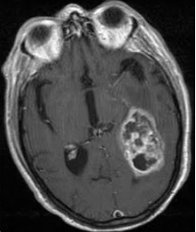
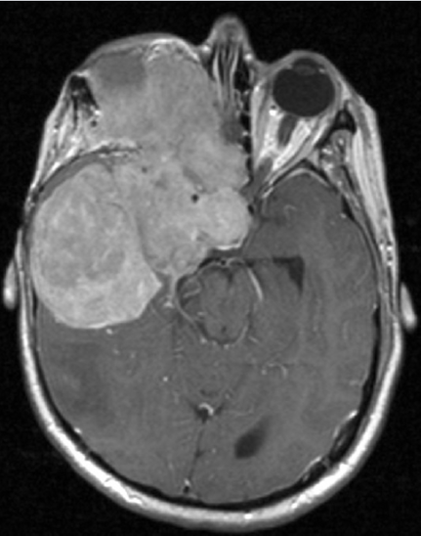
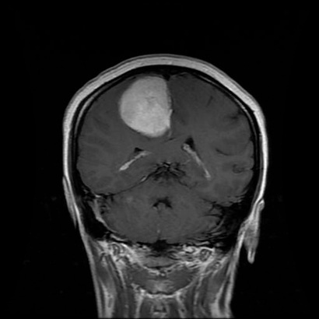
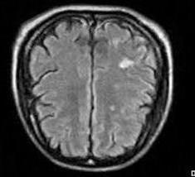
DATASET

Slide 6
METHODOLOGY
Step 1: Data Collection - Gather MRI scan images from publicly available datasets.
Step 2: Data Preprocessing - Perform image normalization, augmentation, and resizing to ensure uniform input data.
Step 3: Model Development - Implement a CNN for tumor classification.
Step 4: Segmentation - Apply K-Means clustering to highlight tumor regions within the MRI images.

Slide 7
METHODOLOGY
Step 5: Training & Validation - Split data into training and validation sets, tune hyperparameters, and optimize the model.
Step 6: Testing & Evaluation - Use accuracy, precision, recall, and F1-score to assess model performance.
Step 7: Deployment - Integrate the trained model into a Flask-based web application where users can upload MRI scans and receive results.

Slide 8


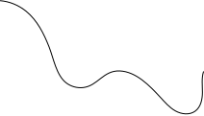

END-TO-END PIPELINE REPRESENTATION
User Uploads MRI Scan
CNN Model for Classification
Preprocessing
Provide Next Steps & Lifestyle Guidance
K-Means Segmentation
Output Tumor Type & Segmented Image

Slide 9
MODEL SELECTION & IMPLEMENTATION
Algorithms Used: CNN for classification, K-Means for segmentation.
Justification: CNNs effectively analyze medical images, while K-Means helps in tumor segmentation. CNNs handle complex patterns, and K-Means provides region-based clustering.

Slide 10
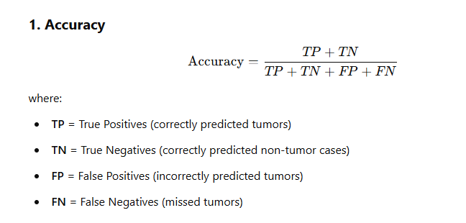
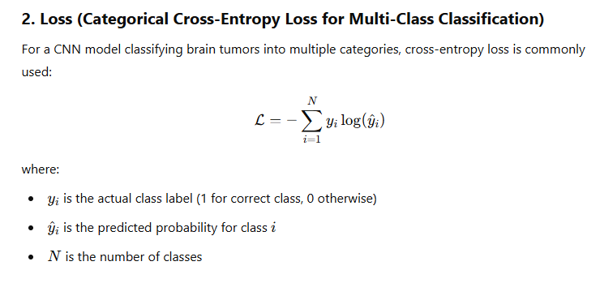
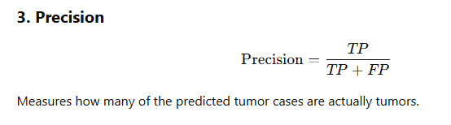
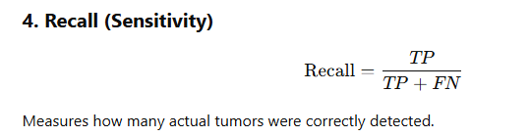
EVALUATION

Slide 11
RESULTS
Accuracy: 0.9830
Loss: 0.0650
Precision: 0.9843
Recall: 0.9823

Slide 12
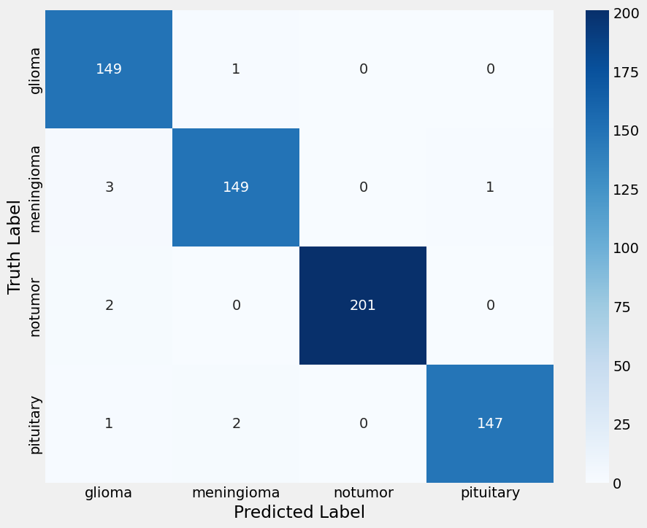
EVALUATION & RESULTS
Confusion Matrix

Slide 13
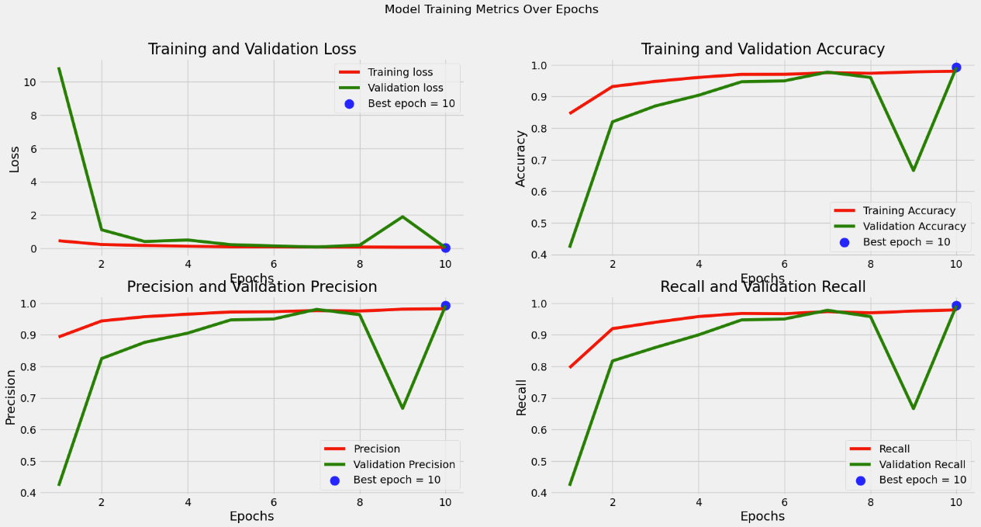
LOSS, ACCURACY, PRECISION AND RECALL
Model Training Metrics Over Epochs

Slide 14
DEPLOYMENT
Platform: Flask-based web application for easy accessibility.
Tools: Flask (backend framework), TensorFlow (deep learning model), OpenCV (image processing), Matplotlib (visualization).

Slide 15
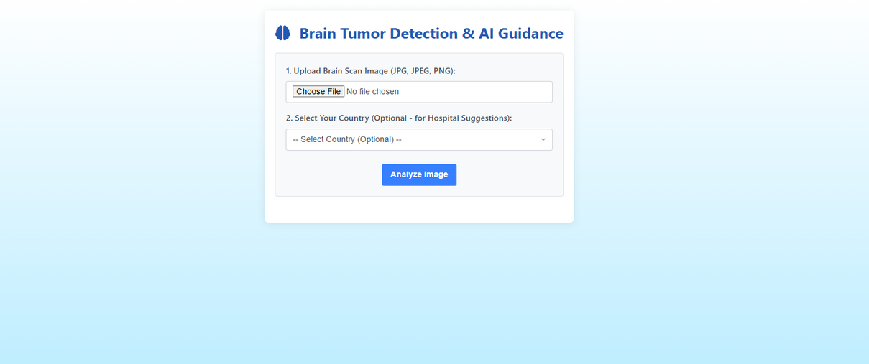
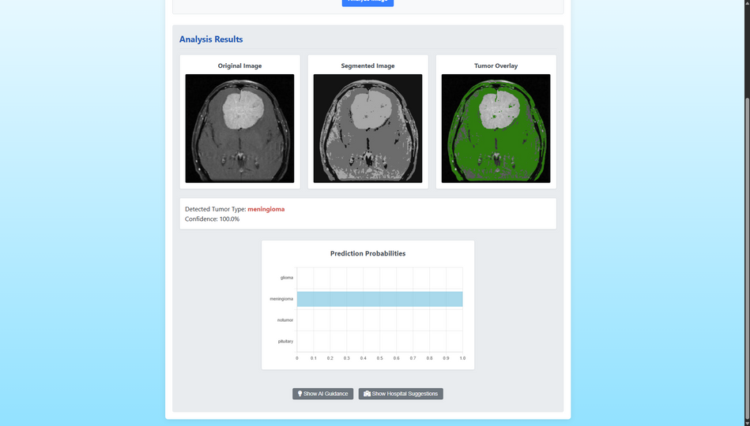
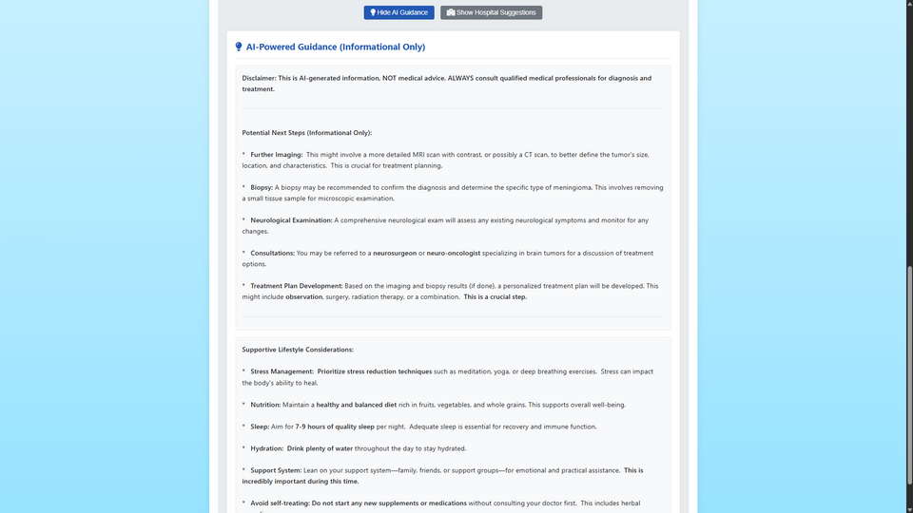
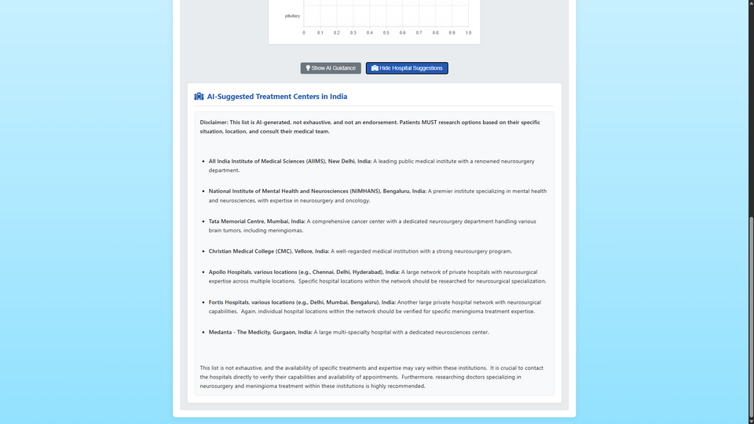
FINAL UI
Input Page
Output
API integrated Guidance
API integrated Hospital suggestion

Slide 16
CHALLENGES & LIMITATIONS
Challenges
Variations in image resolution and contrast affect model performance.
Obtaining large amounts of labeled MRI images is difficult.
Limitations
Model accuracy depends on dataset quality.
Noisy or imbalanced datasets can reduce generalization.
Trade-offs
Higher accuracy often requires a more complex model.
Complex models demand more computational resources, making deployment challenging.

Slide 17
CONCLUSION & FUTURE WORK
AI-driven brain tumor classification enhances early diagnosis and supports medical professionals.
CNNs and K-Means segmentation enable accurate tumor identification and visualization.
Future improvements will refine the dataset and optimize model performance.
Expanding deployment options will increase accessibility and real-world impact.

Slide 18
SCOPE FOR IMPROVEMENT
Using a dataset containing only brain MRIs can enhance model training performance.
Removing the skull from images improves segmentation clarity and accuracy.
Accounting for variations in MRI machines and scan types can improve model generalization.
Access to diverse MRI scans ensures better accuracy and broader compatibility.

Slide 19
FUTURE ENHANCEMENTS
Deploy the model as an application or website for wider accessibility.
Improve the model to support all types of MRI scans and classifications.
Expand the dataset to include diverse MRI scans for various diseases.
Enhance model adaptability for better real-world medical applications.

Slide 20
REFERENCES & ACKNOWLEDGMENTS
Kaggle : https://www.kaggle.com/code/yousefmohamed20/brain-tumor-mri-accuracy-99
TENSORFLOW : https://www.tensorflow.org/
YouTube : https://youtu.be/juJYmc4vrWU?si=GVgc7fFfFerngg3z
Google Scholar : https://www.mdpi.com/2075-1729/13/2/349

Slide 21
THANK
YOU

